Slide 1
Books Store Project SQL
Different Beginner and Advanced Queries + Results + Insights

Slide 2
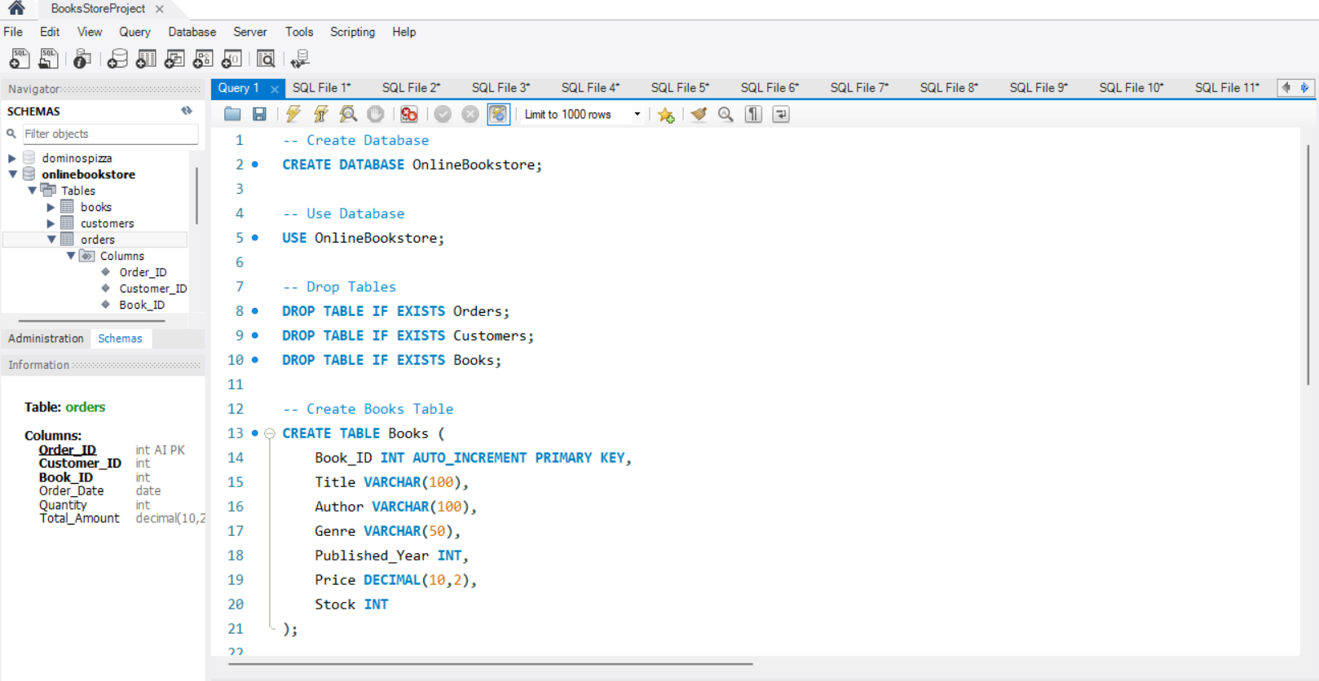
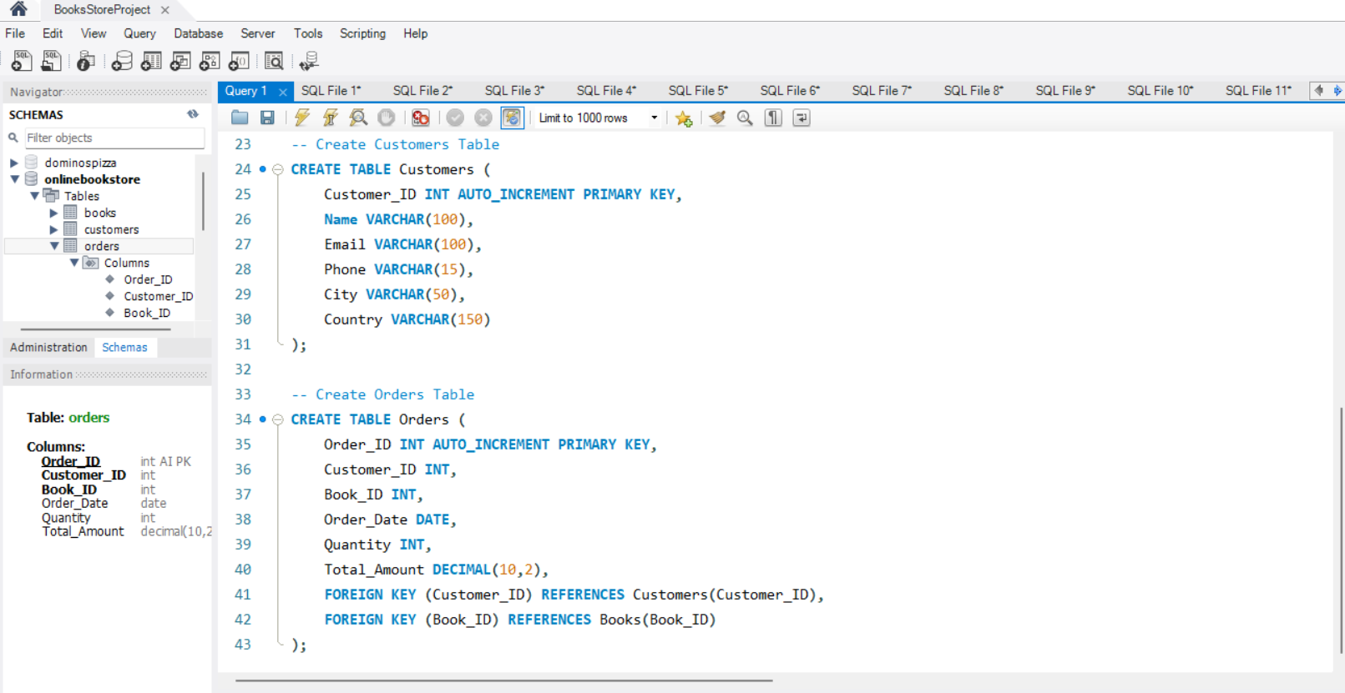
- Create Database - Use Database - Create Books, Customers and Orders Table

Slide 3
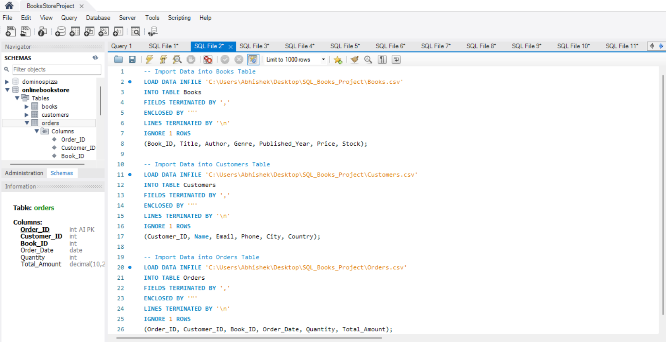
- Importing the data from CSV Files into Books, Customers, and Orders Table

Slide 4
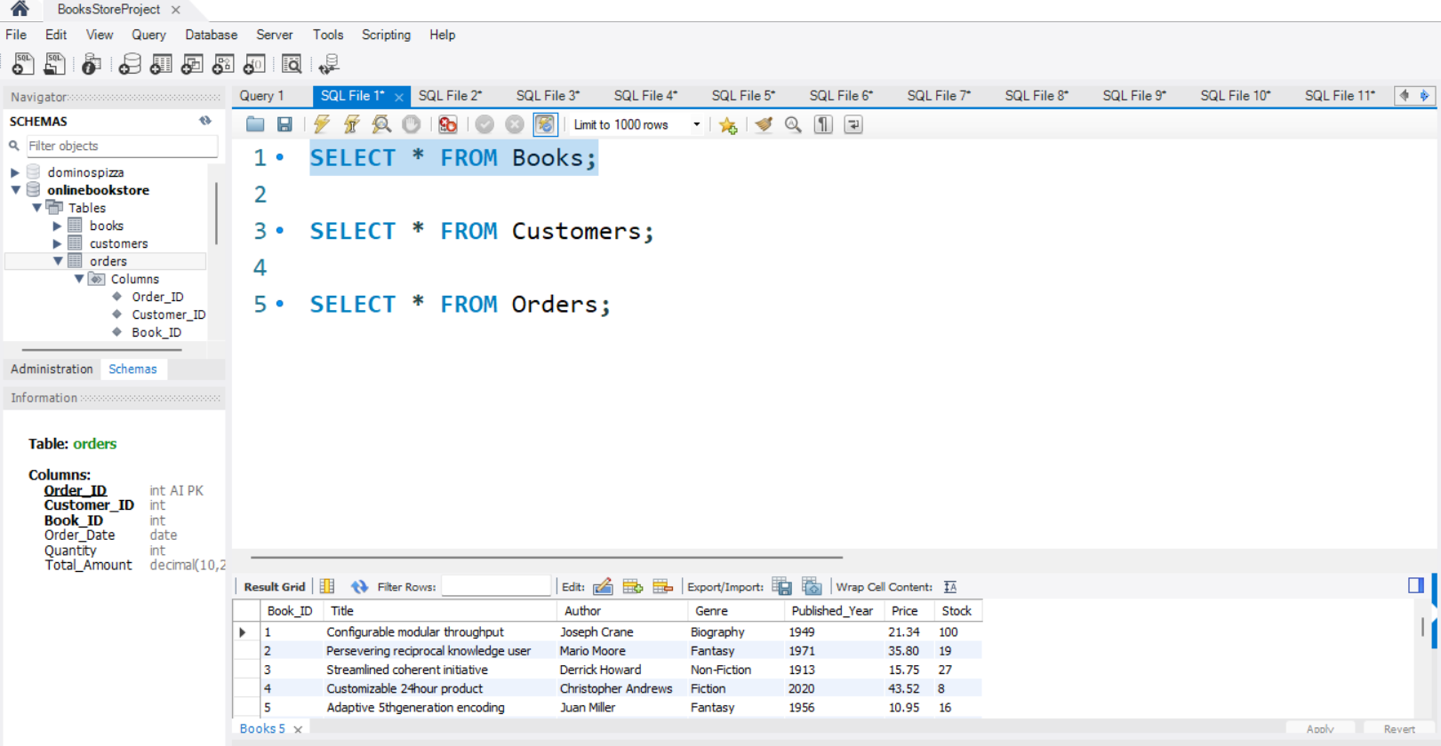
- Looking at how the Books table looks

Slide 5
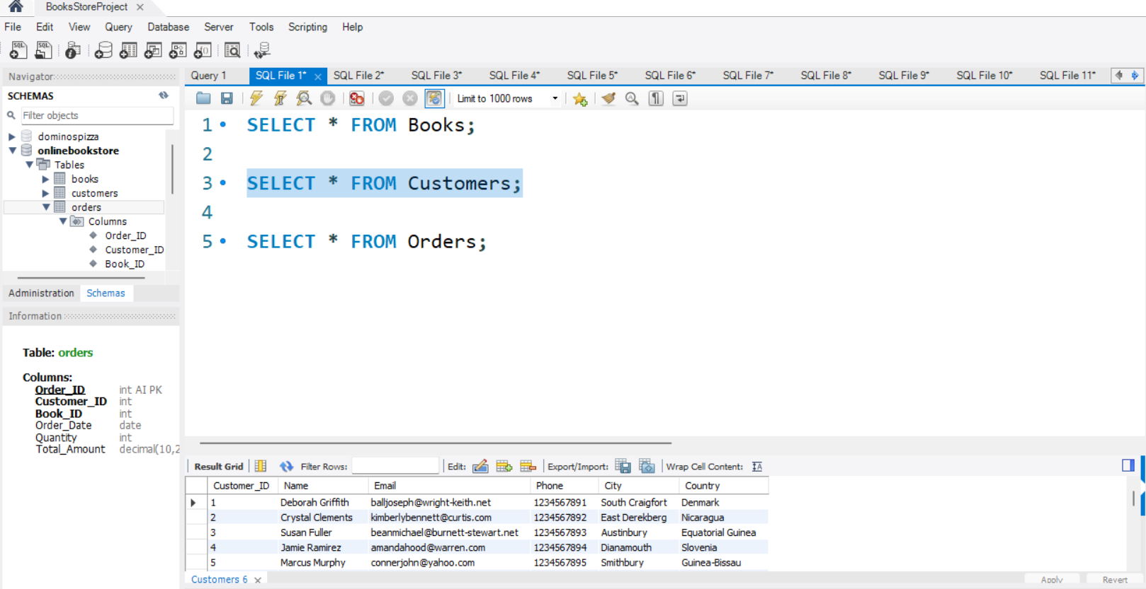
- Looking at how the Customers table looks

Slide 6
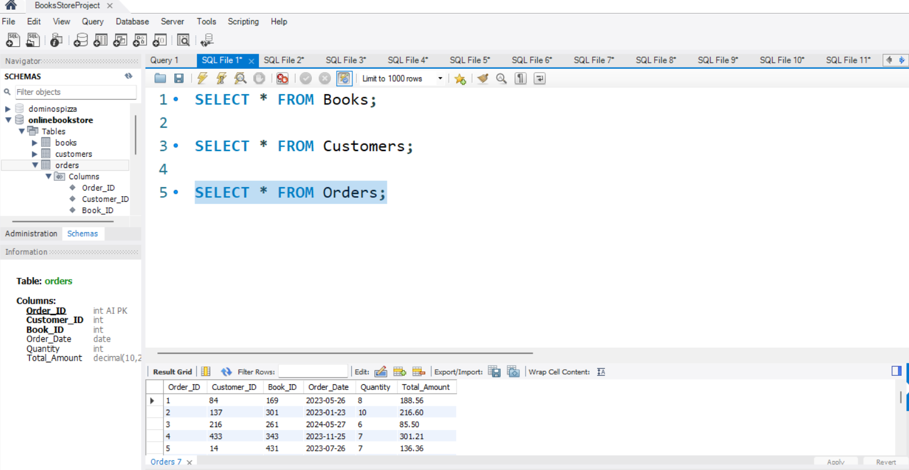
- Looking at how the Orders table looks

Slide 7
BEGINNER QUESTIONS

Slide 8
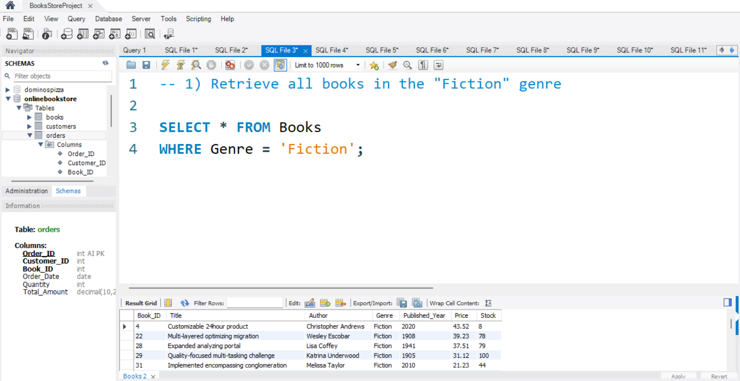
1) Retrieve all books in the "Fiction" genre Insight: This query helps identify all books that belong to the Fiction category.

Slide 9
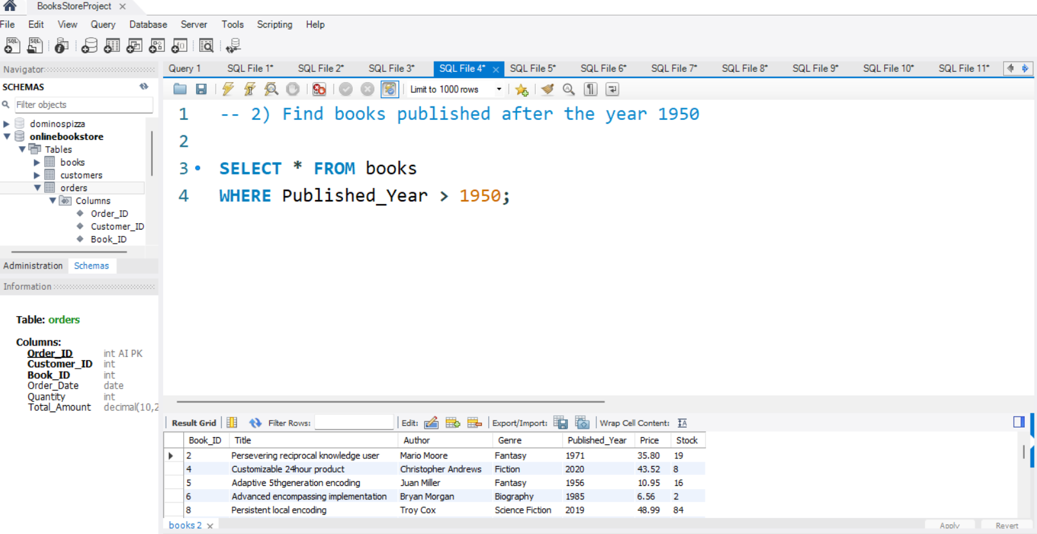
2) Find books published after the year 1950 Insight: This query shows modern books published after 1950.

Slide 10
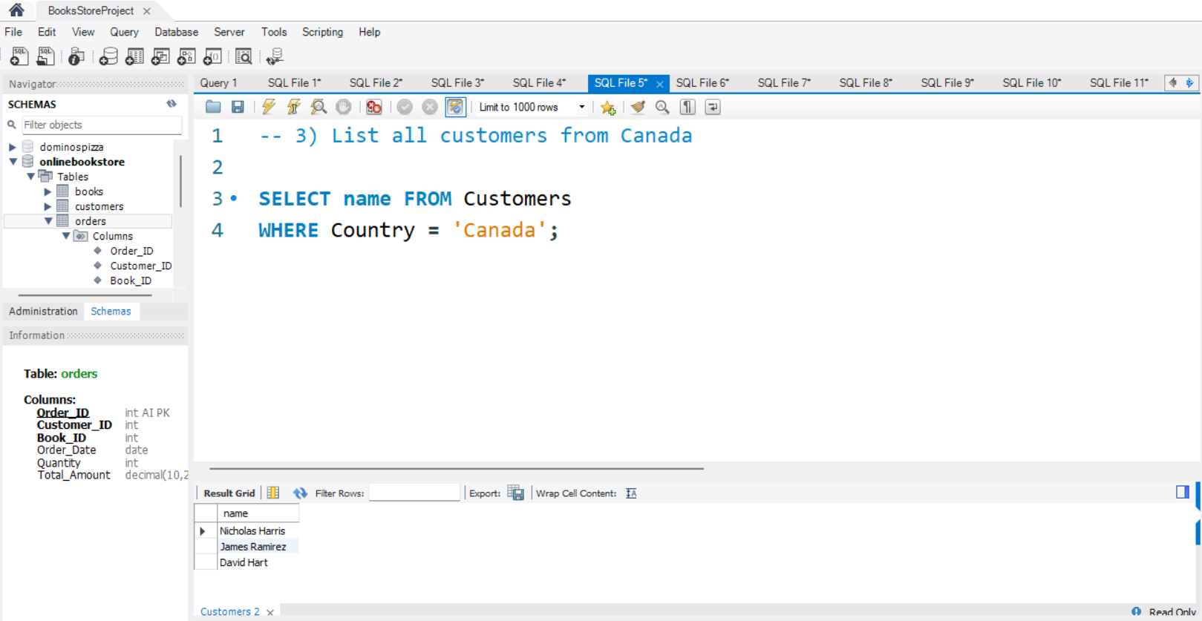
3) List all customers from Canada Insight: This query helps find customers located in Canada.

Slide 11
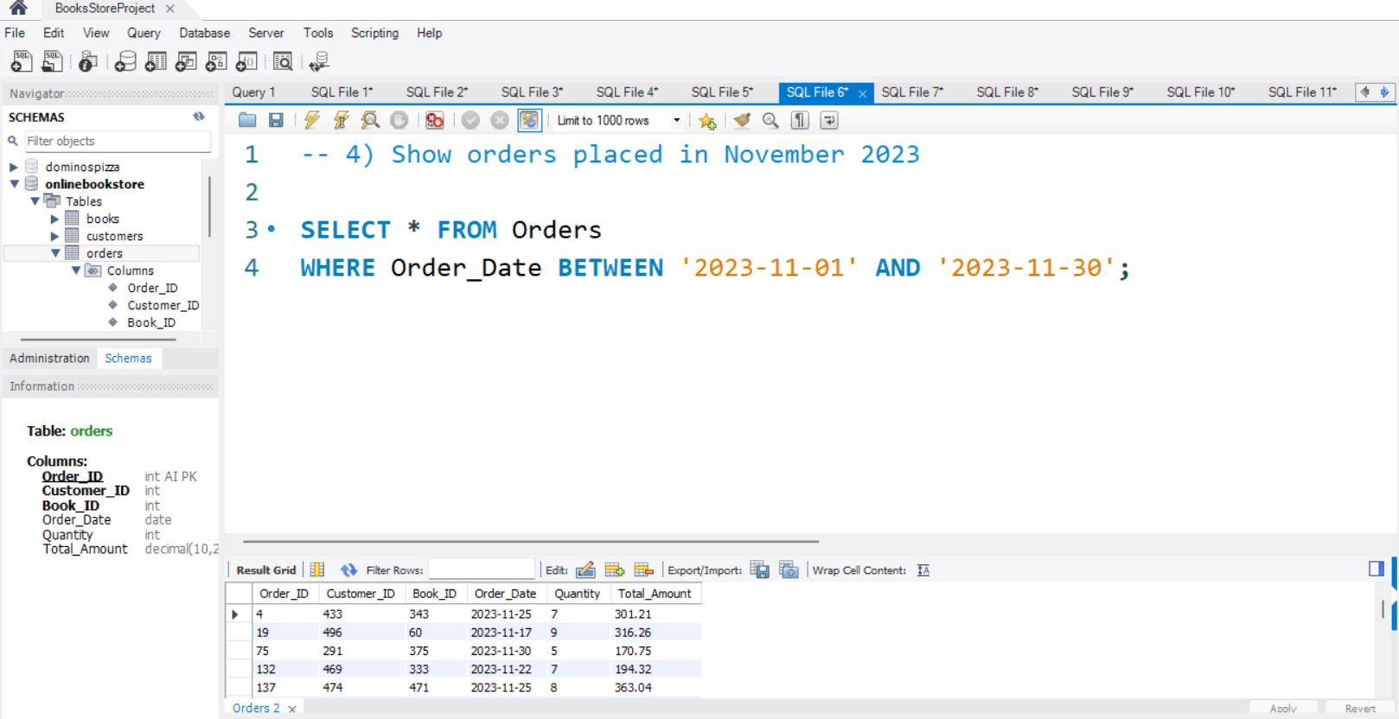
4) Show orders placed in November 2023 Insight: This query helps analyze monthly order activity for November 2023.

Slide 12
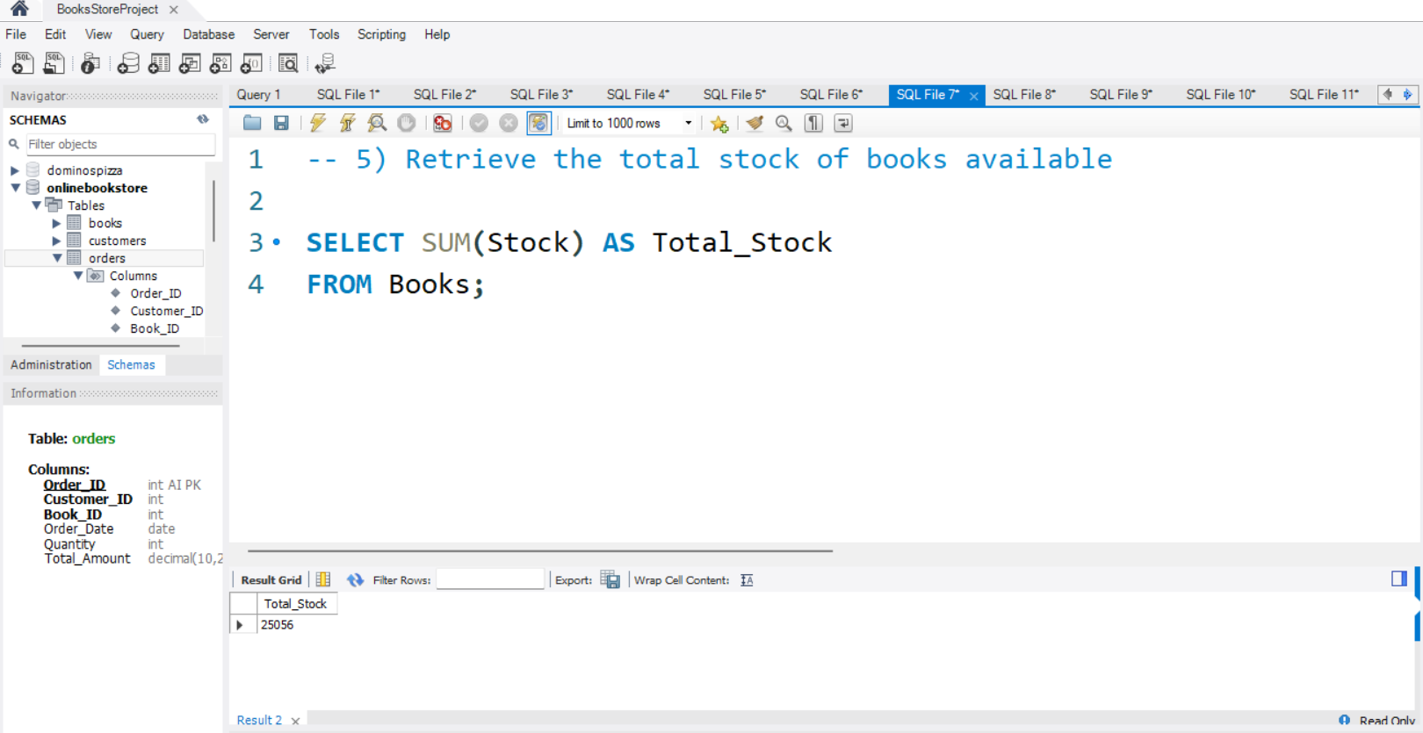
5) Retrieve the total stock of books available Insight: This query gives the total number of books currently available in inventory.

Slide 13
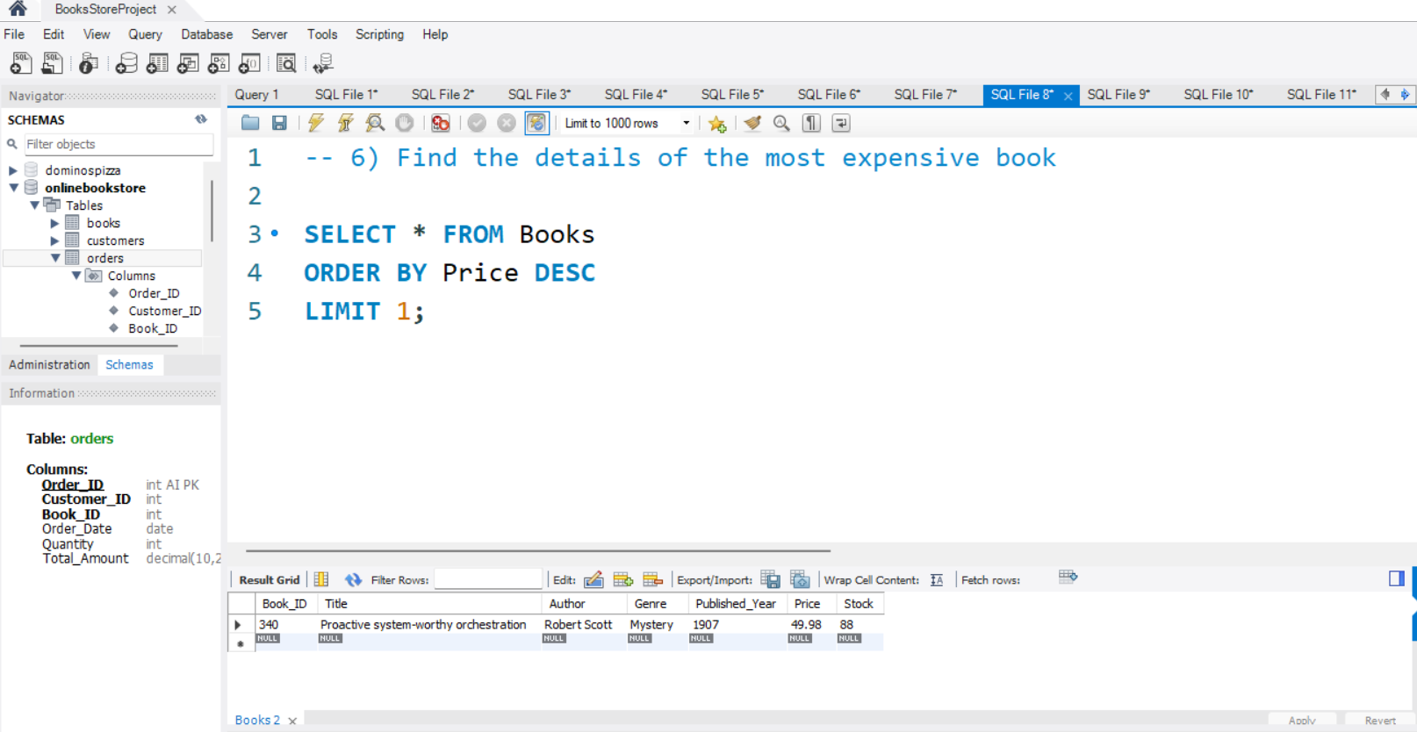
6) Find the details of the most expensive book Insight: This query identifies the highest-priced book in the bookstore.

Slide 14
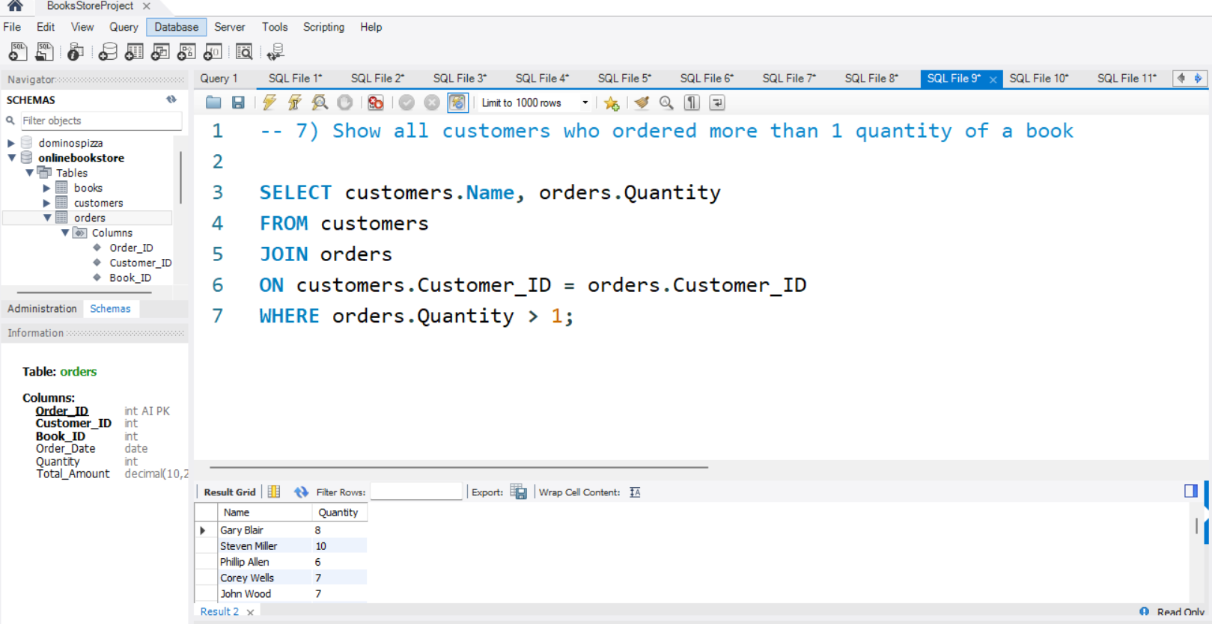
7) Show all customers who ordered more than 1 quantity of a book Insight: This query shows customers who purchased more than one copy of a book in a single order.

Slide 15
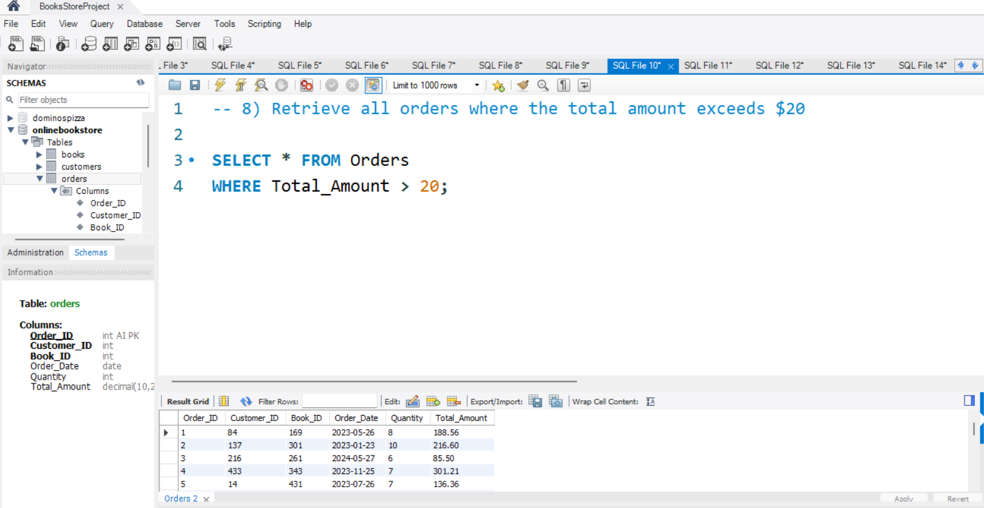
8) Retrieve all orders where the total amount exceeds $20 Insight: This query helps identify higher-value orders above $20.

Slide 16
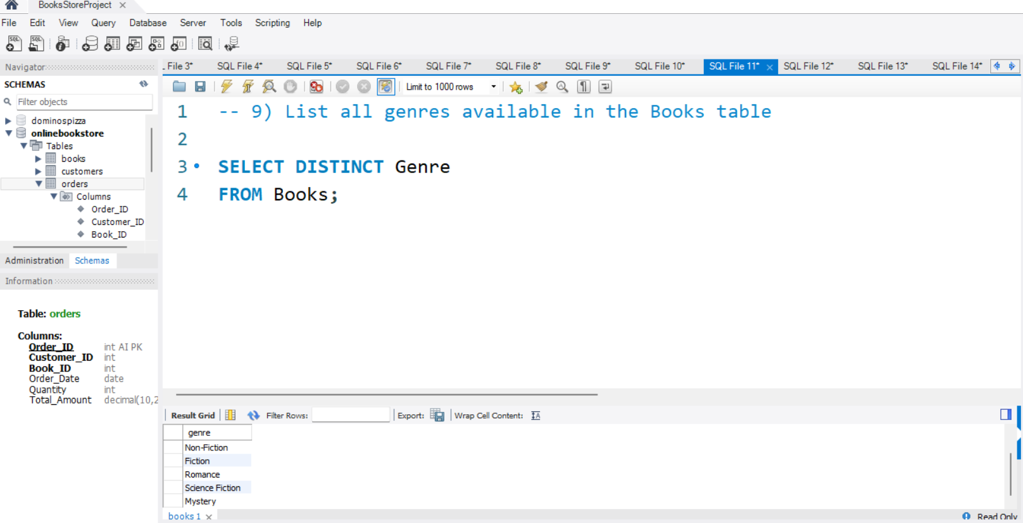
9) List all genres available in the Books table Insight: This query displays all unique book genres available in the bookstore.

Slide 17
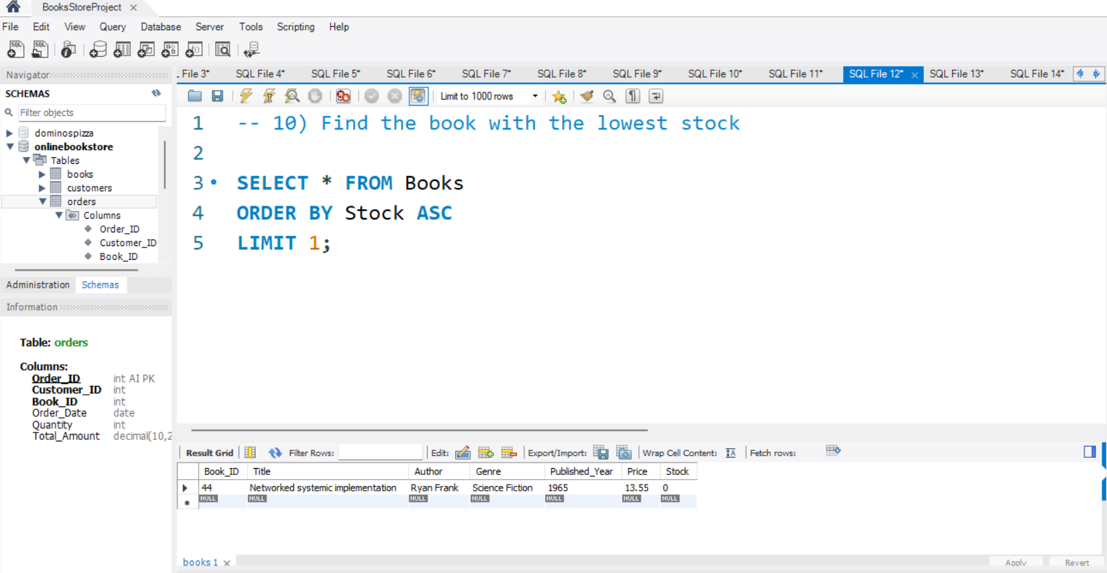
10) Find the book with the lowest stock Insight: This query identifies the book with the least available stock, useful for restocking decisions.

Slide 18
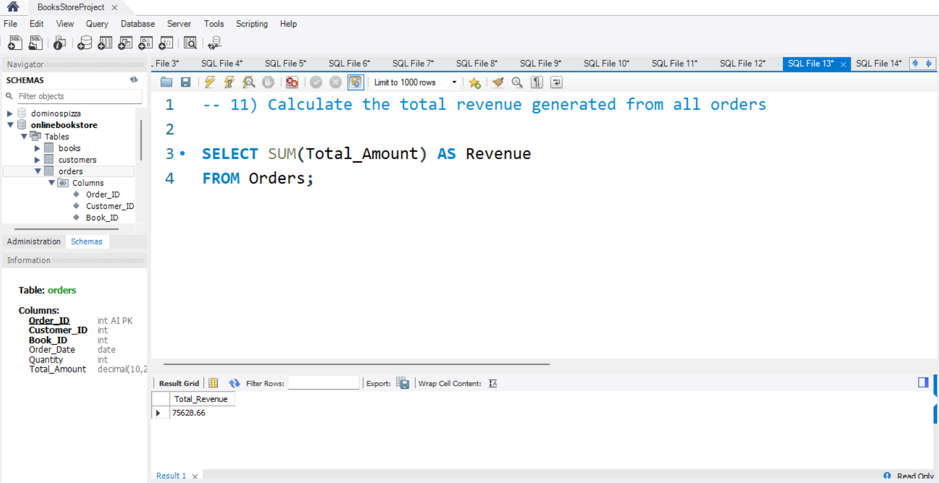
11) Calculate the total revenue generated from all orders Insight: This query calculates the overall revenue generated from book sales.

Slide 19
ADVANCED QUESTIONS

Slide 20
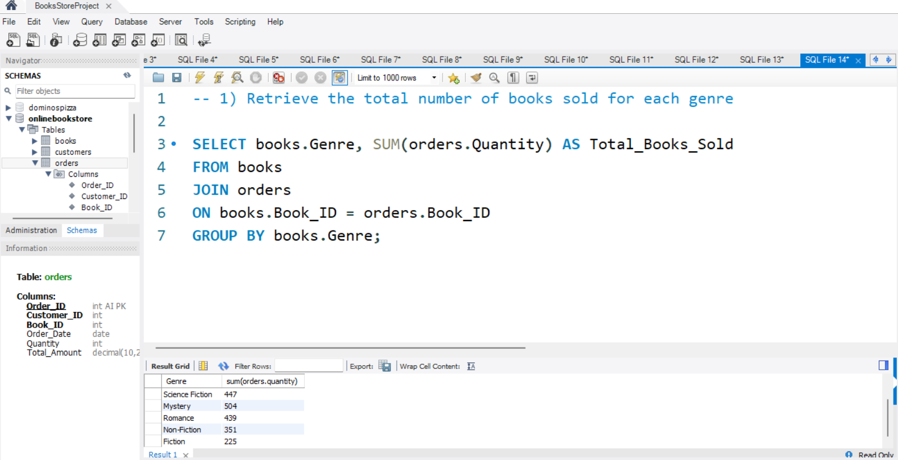
1) Retrieve the total number of books sold for each genre Insight: This query shows which genres are selling the most based on total quantity sold.

Slide 21
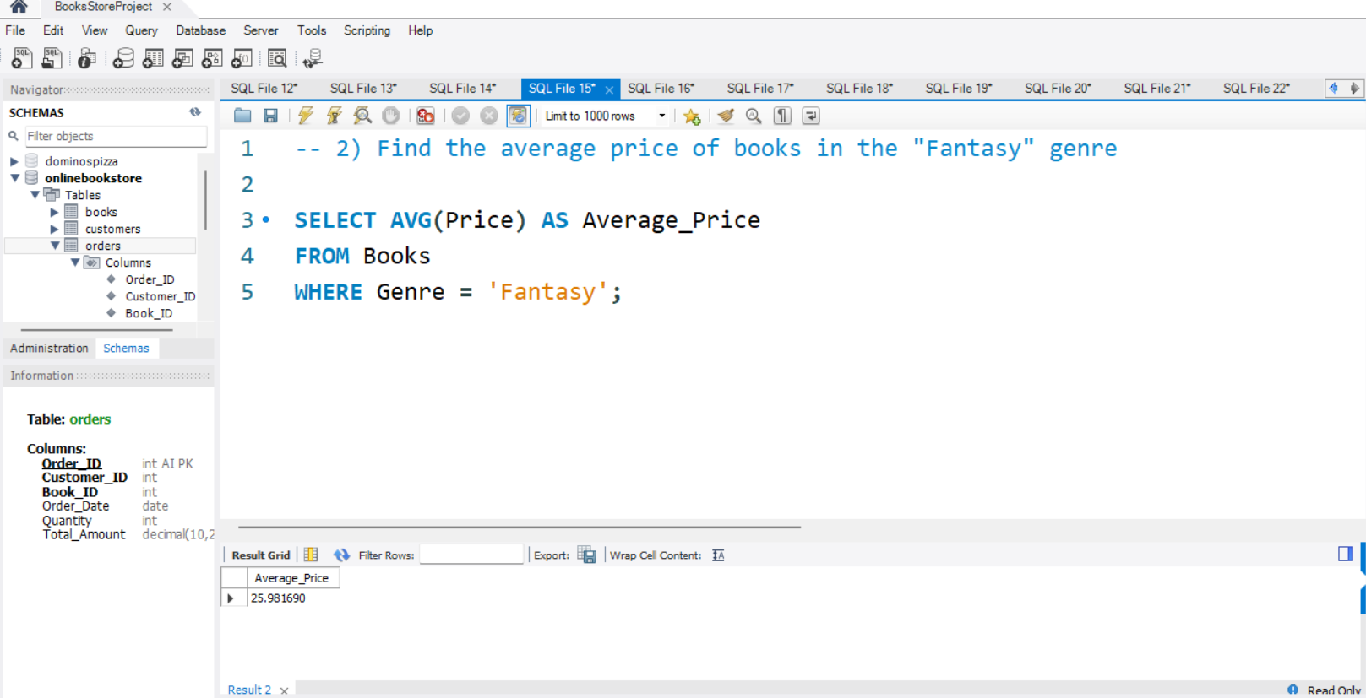
2) Find the average price of books in the "Fantasy" genre Insight: This query calculates the average price of Fantasy books.

Slide 22
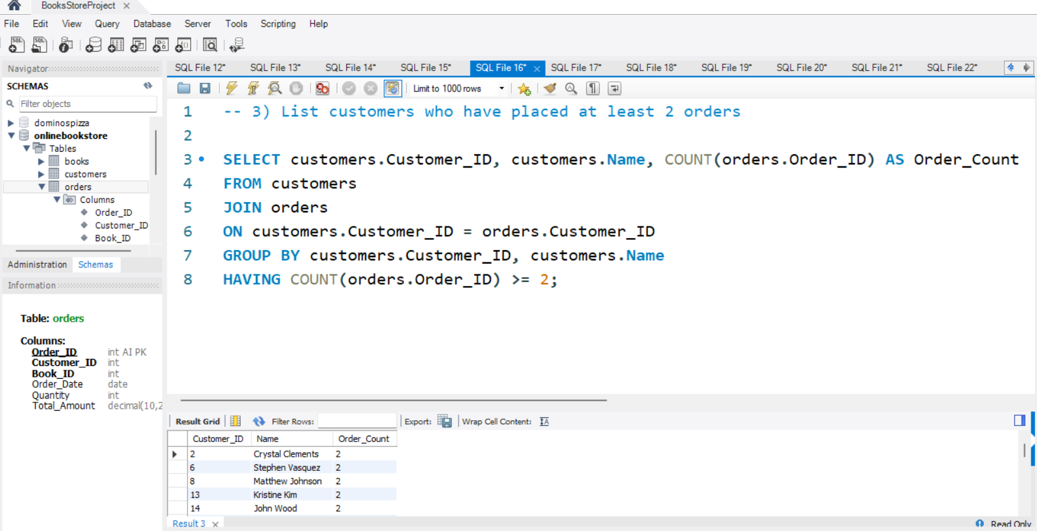
3) List customers who have placed at least 2 orders Insight: This query identifies repeat customers who have placed two or more orders.

Slide 23
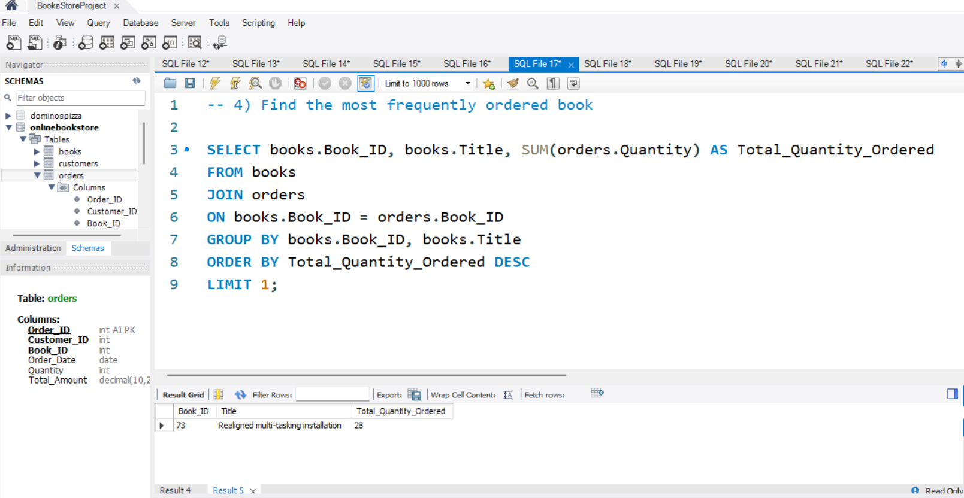
4) Find the most frequently ordered book Insight: This query finds the most popular book based on total quantity ordered.

Slide 24
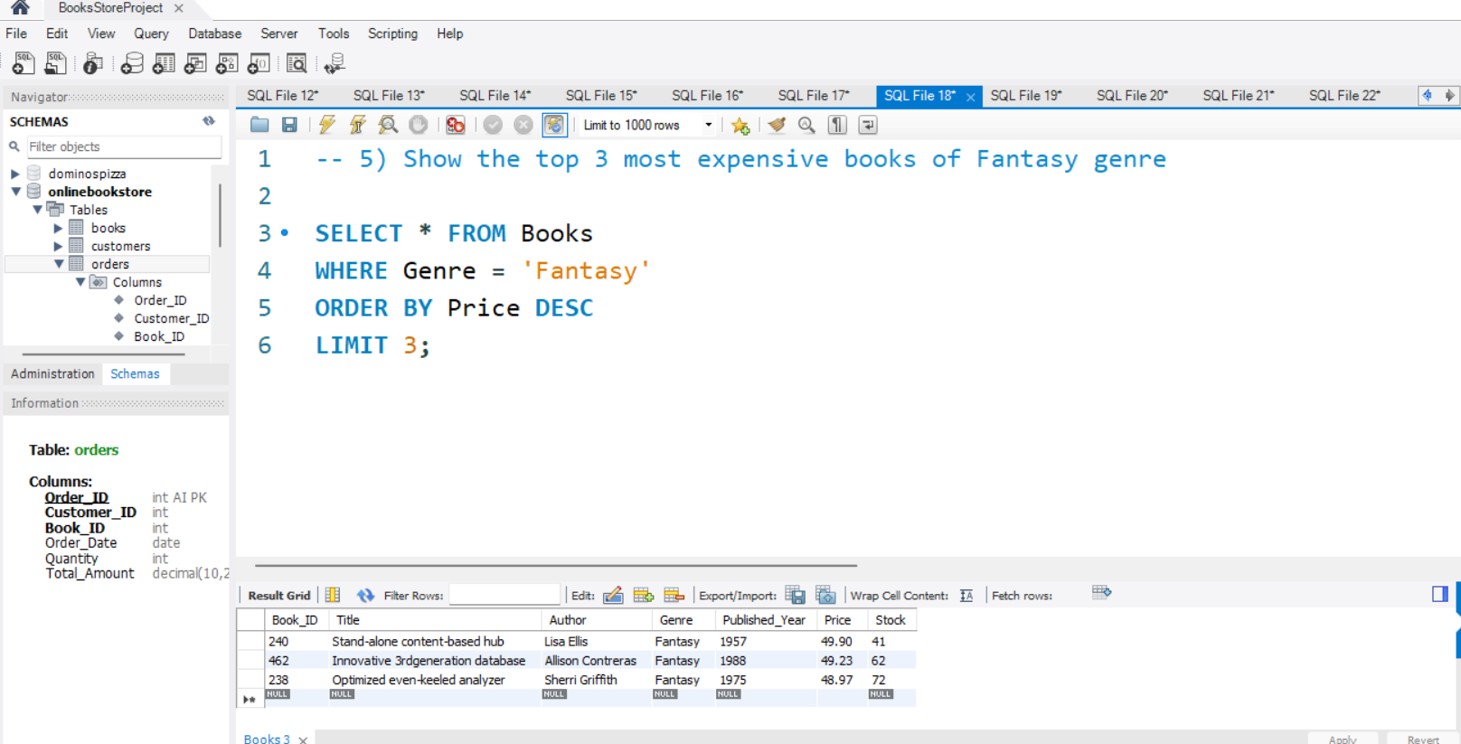
5) Show the top 3 most expensive books of Fantasy genre Insight: This query highlights the top 3 highest-priced Fantasy books.

Slide 25
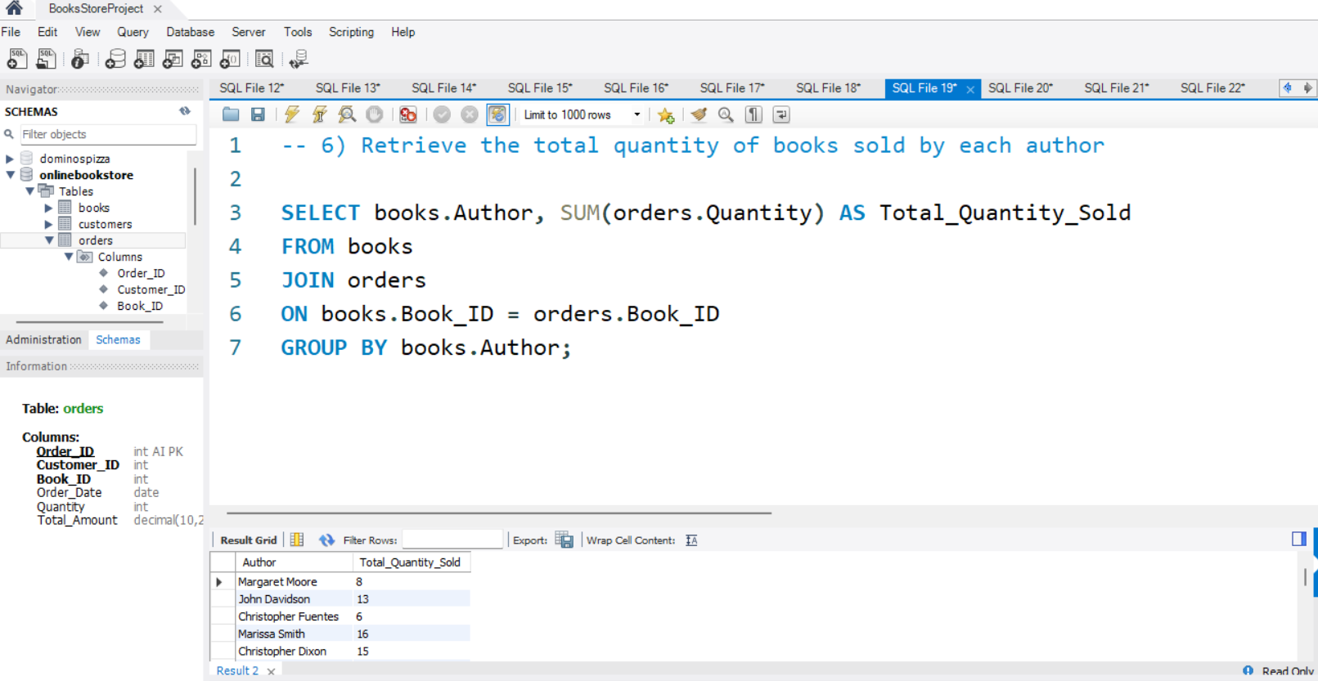
6) Retrieve the total quantity of books sold by each author Insight: This query shows author-wise sales performance based on total books sold.

Slide 26
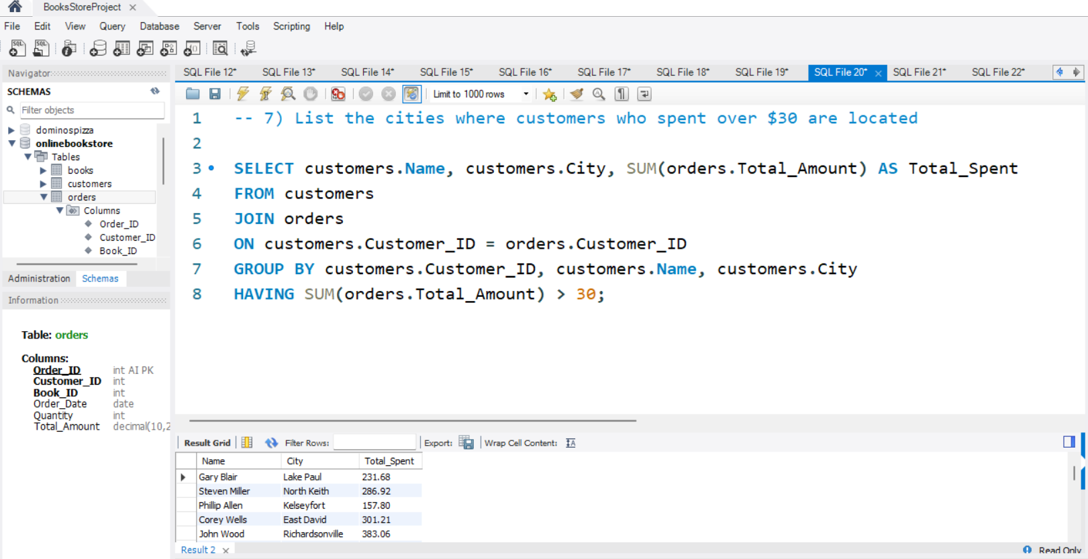
7) List the cities where customers who spent over $30 are located Insight: This query identifies customers and cities where total spending is more than $30.

Slide 27
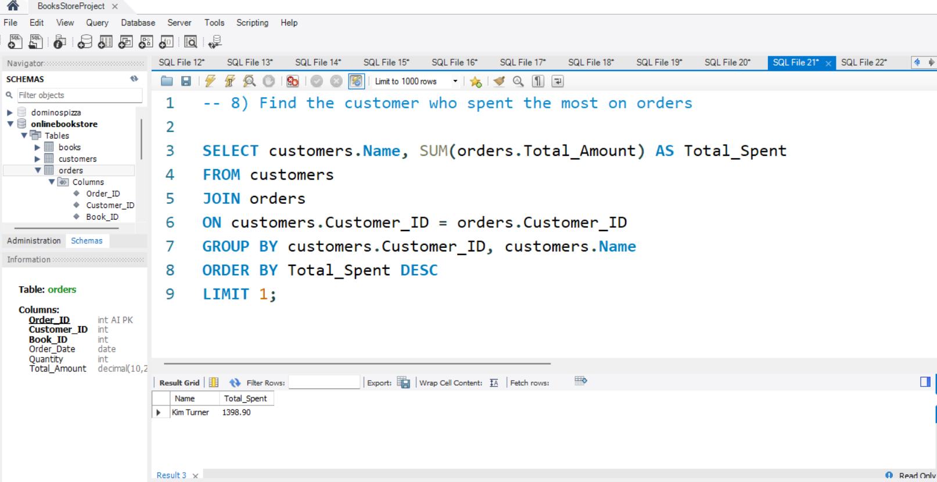
8) Find the customer who spent the most on orders Insight: This query finds the highest-spending customer of the bookstore.

Slide 28
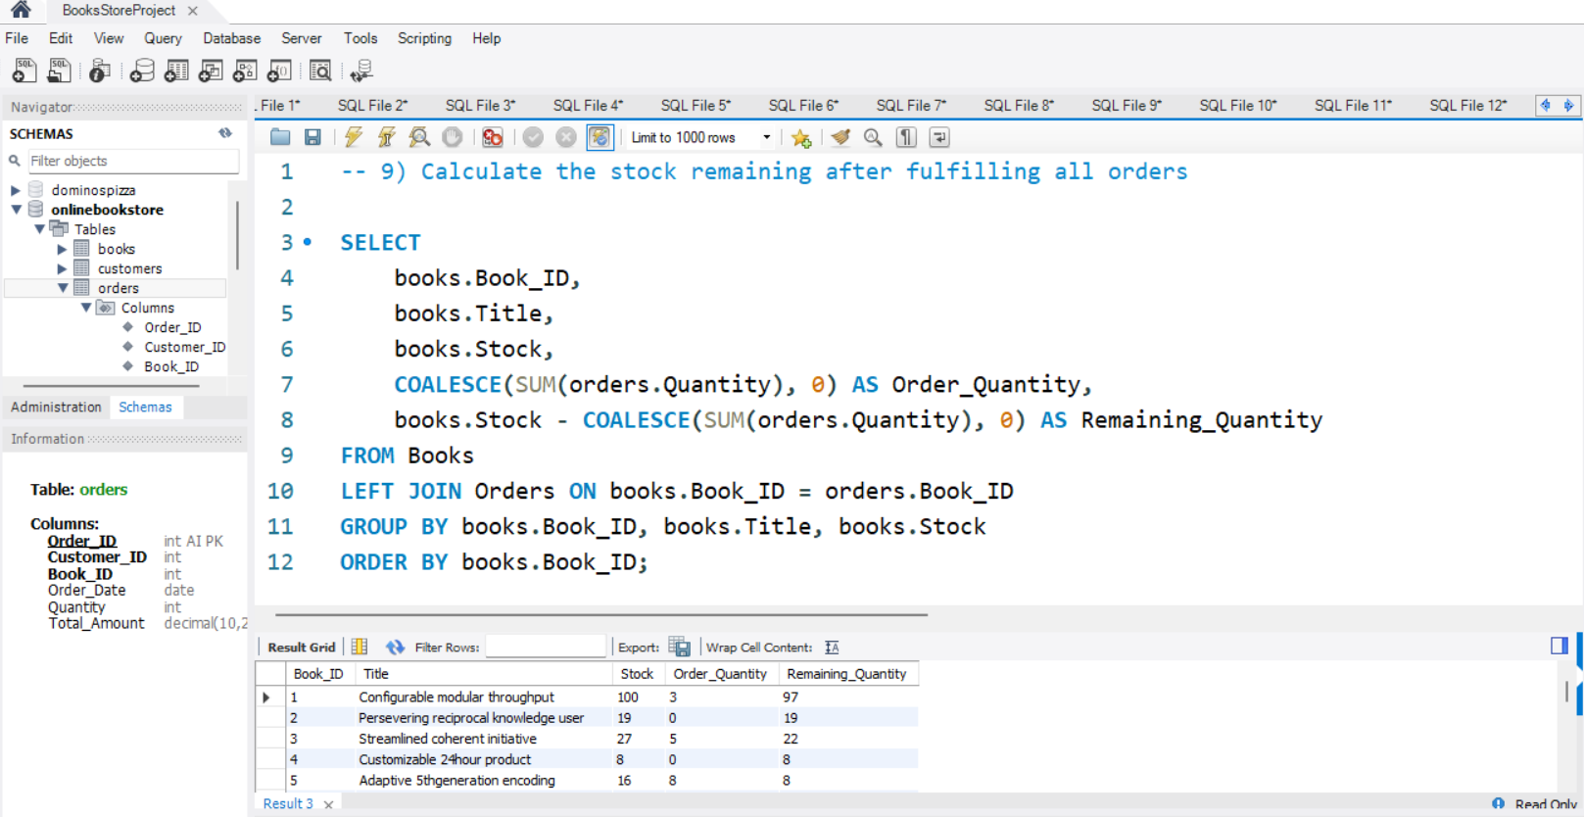
9) Calculate the stock remaining after fulfilling all orders Insight: This query calculates remaining stock for each book after subtracting sold quantities. It also includes books with no orders because LEFT JOIN is used.

